Slide 1
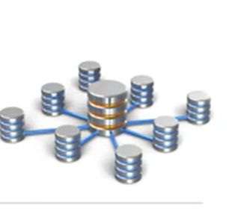
Chapter 6
Data warehousing and data mining techniques

Slide 2
Chapter outline
Introduction to Data warehousing
Why Data warehousing
Data warehousing and online transaction processing
Introduction to data mining
Data mining techniques

Slide 3
Introduction to Data warehousing
A data warehouse as a storehouse, is a repository of data collected from multiple data sources (often heterogeneous) and is intended to be used as a whole under the same unified schema.
Data Warehousing is the process of collecting, storing, and managing large volumes of historical data from multiple sources to support analysis, reporting, and decision making.
It gives the option to analyze data from different sources under the same roof.
Data warehousing involves data cleaning, data integration, and data consolidations.
Generally A data warehouse is a centralized repository of integrated data from one or more different, separate sources.

Slide 4
Cont..
A database stores current operational data needed to run daily business activities.
Example:
University database storing:
  Student registration
  Course enrollment
  Exam results
This data change frequently
A data warehouse stores historical data collected from multiple databases for analysis and reporting.
Example:
University data warehouse used to analyze:
  Student performance over 5 years
  Enrollment trends by department
  Graduation rates
This data is mostly read-only.

Slide 5
How Data warehouse works?
A Data Warehouse works as a central repository where information arrives from one or more data sources.
Data flows into a data warehouse from the transactional system and other relational databases.
With in each database data organized into row and columns.
A data warehouse merges information coming from different sources into one comprehensive database tables can be organized inside schema which are think as folder.
By merging all of this information in one place, an organization can analyze its customers more holistically. This helps to ensure that it has considered all the information available.

Slide 6
Benefits of Data Warehouse
Centralized Data Repository:- Combines data from multiple sources into one place.
To facilitate reporting as well as analysis
Informed decision making:- Provides accurate, integrated, and historical data
Historical Data Analysis :- Enables time-based analysis (monthly, yearly trends) Stores data over long periods (years).
Faster Query Performance:- Optimized for complex analytical queries

Slide 7
Characteristics of Data warehouse
Subject-Oriented:- Data warehouse contains data organized by topics. E.g. Sales, marketing, finance, etc.
Time variant:- Data warehouse contains data that reflect what happened last week, last month, past five years, and so on. Time based reporting .
Integrated :- centralized, consolidated database that integrates data derived from the entire organization.
Non volatile:- Once data enter the data warehouse, they are never removed. Because the data in the warehouse represent the company‘s entire history.
7
7
Notes:
7

Slide 8
Data warehousing and online transaction processing
Two minor systems that are useful in managing this data include Data Warehousing (DWH) as well as Online Transaction Processing (OLTP).
Data Warehousing is a technique that gathers or collects data from different sources into a central repository, or, in other words, a single, complete, and consistent store of data that is obtained from different sources.
It is a powerful database model that enhances the user’s ability to analyze huge, multidimensional datasets.

Slide 9
Online-Transaction Processing /OLTP/
It is a technique used for detailed day-to-day transactions of data which continuously chain on an everyday-basis.
We can describe OLTP support daily operational activities of an organization by processing a large number of short, fast, and concurrent transactions in real time.
It is featured by a large number of short on-line transactions (INSERT, UPDATE, and DELETE).
OLTP or Online Transaction Processing is a type of data processing that consists of executing a number of transactions occurring concurrently—online banking, shopping, order entry, or sending text messages, for example.
The primary significance of OLTP operations is put on very rapid query processing, maintaining record integrity in multi-access environments, and effectiveness consistent by the number of transactions per second.

Slide 10
eg
Example 1: Banking System (ATM / Mobile Banking)
OLTP Activities
Deposit money
Withdraw money
Transfer funds
Example 2: University Student Registration System
OLTP Activities
Register new students
Add or drop courses
Enter grades
Update student profiles

Slide 11
eg
Example 1: Bank Data Warehouse
Data Stored
10 years of transaction history
Customer demographics
Loan and credit data
Example 2: University Data Warehouse
Data Stored
Student performance over many years
Enrollment trends
Graduation and dropout data

Slide 12
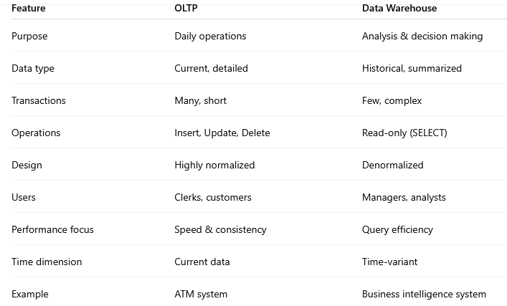

Slide 13
Introduction to data mining
Data mining refers to extracting or mining knowledge from large amounts of data.
It is a process of extracting and discovering patterns in large data sets and get patterns or knowledge from huge amount of data.
The main goals of data mining is to discover meaningful patterns, relationships, trends, and knowledge from large volumes of data
Data warehouse stores data → data mining analyzes data

Slide 14
Cont..
Data Mining Process (KDD Model)
1. Data Cleaning
Remove noise, errors, and missing values
Handle duplicate records and inconsistencies
Example:
Removing incomplete student records from a university database.
2. Data Integration
Combine data from multiple sources into one dataset
Example:
Merging student data from admission, exam, and finance systems.
3. Data Selection
Select relevant data for the mining task
Example:
Selecting only GPA, attendance, and exam scores to analyze student performance.

Slide 15
4. Data Transformation
Convert data into a suitable format
Normalize, aggregate, or encode data
Example:
Converting raw marks into grade categories (A, B, C).
5. Data Mining (Core Step)
Apply algorithms to extract patterns
6 Pattern Evaluation
Identify interesting and useful patterns
Remove irrelevant or redundant results
Example:
Keeping only rules with high confidence like
“Students with attendance > 80% usually pass.”

Slide 16
7. Knowledge Presentation
Present results in a human-understandable form
Use graphs, reports, dashboards
Example:
Charts showing student performance trends.

Slide 17
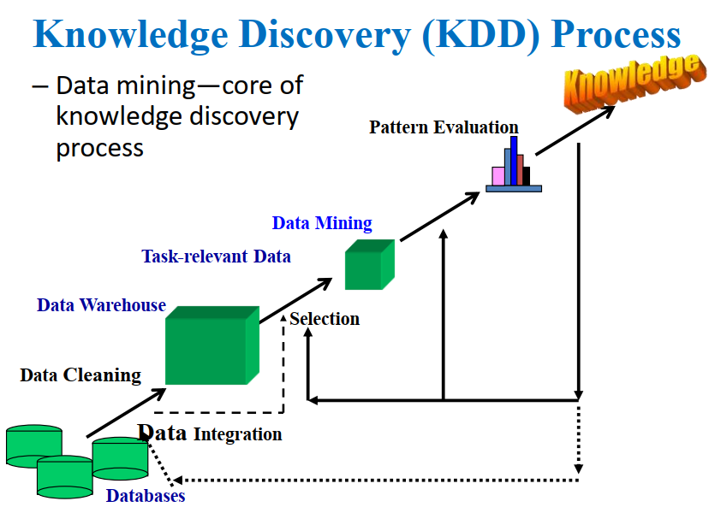

Slide 18
Data Mining Techniques
Classification
Assigns data to predefined classes
Uses labeled data (supervised learning)
Examples:
  Pass / Fail students
  Spam / Not Spam emails
Techniques: Decision Trees, Naïve Bayes, Neural Networks
Clustering
Groups similar data items
No predefined classes (unsupervised learning)

Slide 19
Cont..
Examples:
Group customers by buying behavior
Group students by performance
Techniques: K-means, Hierarchical clustering
Association Rule Mining
Finds relationships between items
Uses IF–THEN rules
Example:
  If a customer buys bread → they also buy butter
Algorithm: Apriori

Slide 20
Cont..
Regression
Predicts numerical values
Finds relationship between variables
Examples:
  Predict salary based on experience
  Predict sales amount
  Predicting student GPA
Types: Linear regression, Multiple regression
Anomaly (Outlier) Detection
Identifies unusual or abnormal data
Examples:
  Fraud detection
  Network intrusion detection

Slide 21
Cont..
Example (University)
Data Warehouse:
Stores student records, grades, attendance for many years
Data Mining:
  Predict students at risk of failure
  Group students by performance
  Find factors affecting GPA

Slide 22
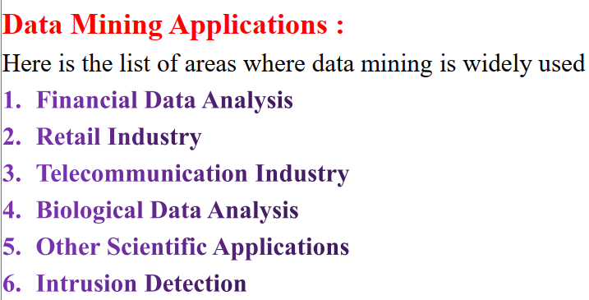

Slide 23
Conclusion
Data mining is the task of discovering interesting patterns from large amounts of data, where the data can be stored in databases, data warehouses, or other information repositories.
It is a young interdisciplinary field, drawing from areas such as database systems, data warehousing, statistics, machine learning, data visualization, information retrieval, and high-performance computing

Slide 24
?

